Slide 1


Flexible Use of Airspace
Civil Aviation University of China
Civil Aviation University of China

Slide 2
Learning Objectives
Define the concept of FUA
List the different airspace structures that are particularly suited for FUA
State the functions of the three levels of ASM
References:
GUIDANCE THE IMPLEMENTATION OF THE CONCEPT OF THE FLEXIBLE USE OF AIRSPACE

Slide 3
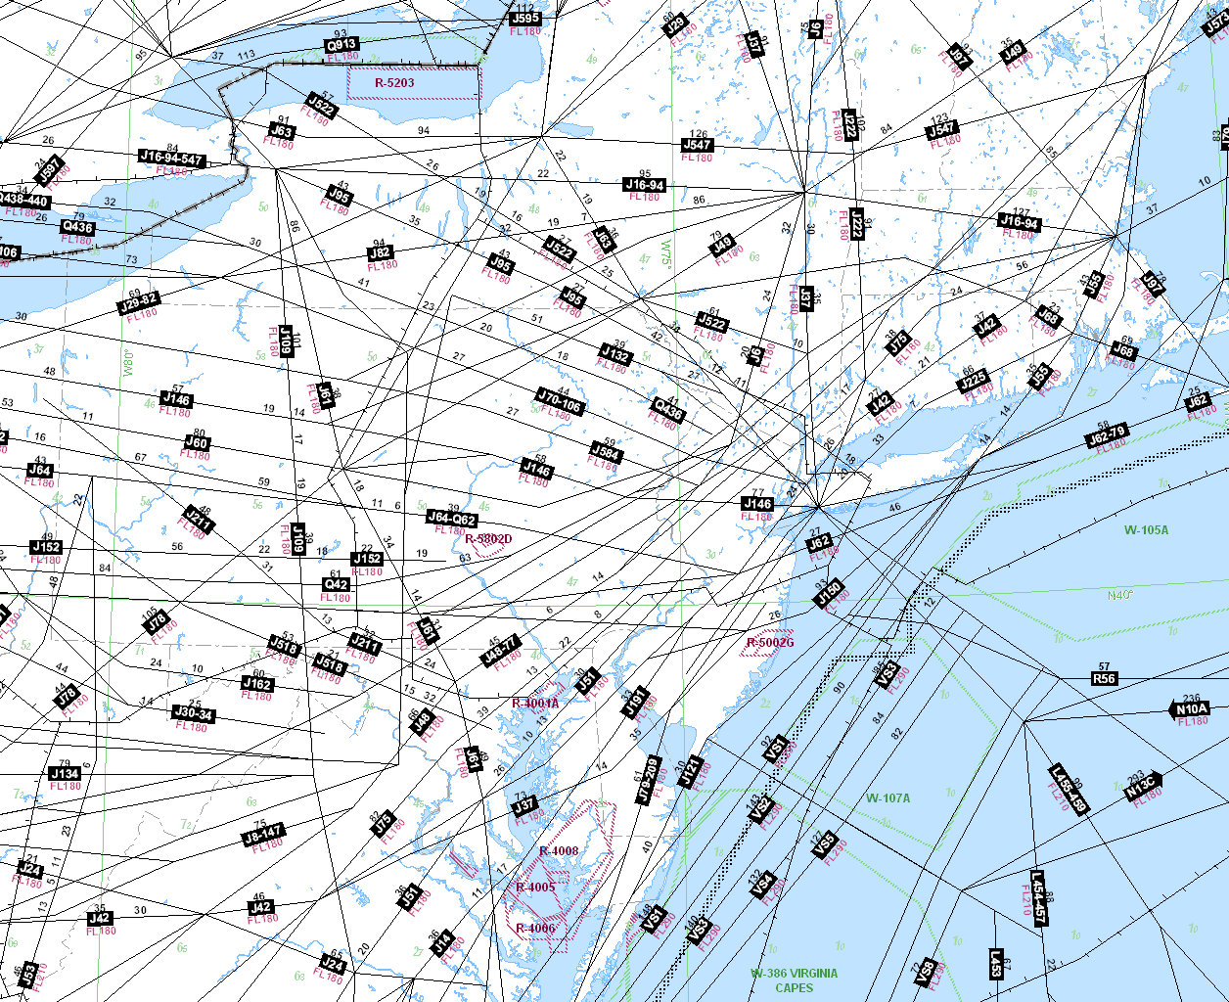
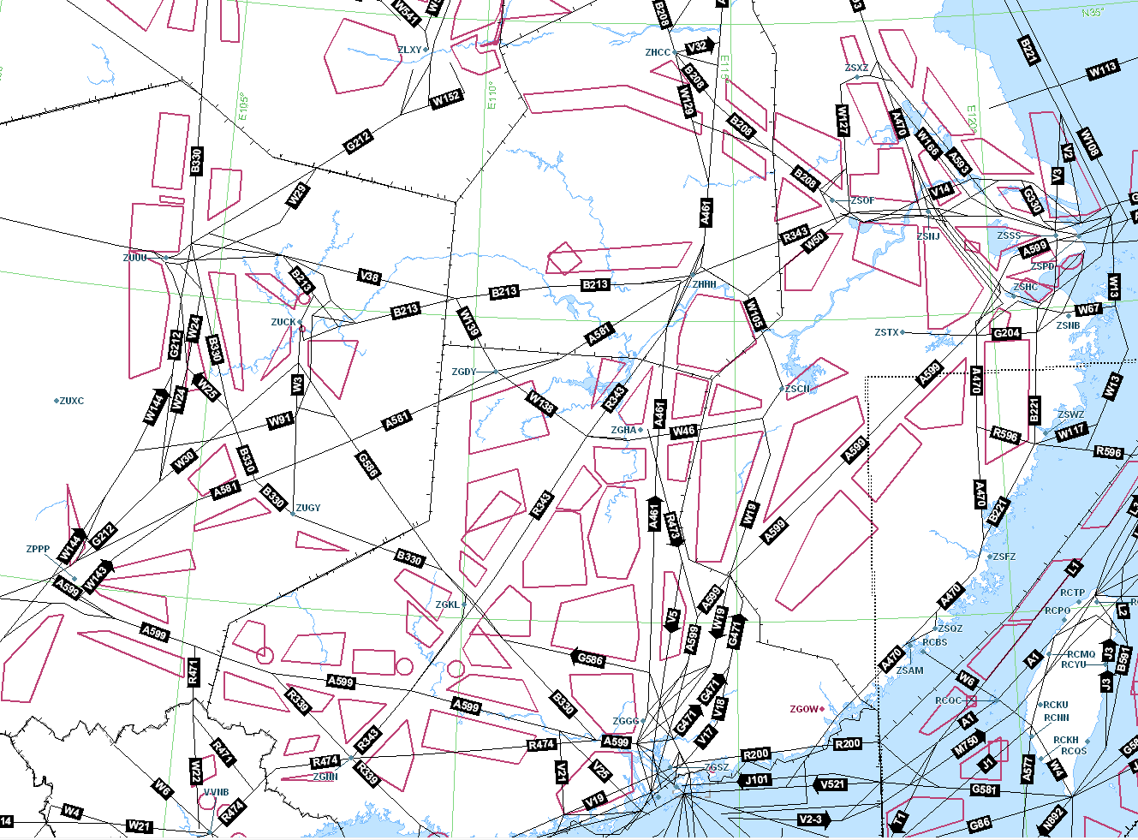
Current Situation
USA
PRC

Slide 4
FUA Concept
Airspace should no longer be designated as either military or civil airspace but should be considered as one continuum and used flexibly on a day-to-day basis.
Consequently, any necessary airspace segregation should be only of a temporary nature.
The daily allocation of flexible airspace structures, that any necessary segregation of airspace is based on real usage within a specific time period.
FUA Concept uses airspace structures that are particularly suited for temporary allocation and/or utilization.
The different airspace structures includes:
Conditional Routes (CDRs),
Temporary Reserved Areas (TRAs),
Temporary Segregated areas (TSAs), or
Cross-Border Areas (CBAs) and
Prior Co-ordination Airspace (PCA) or
Reduced Co-ordination Airspace (RCA) procedures.

Slide 5
Process to determine requirement for temporary segregation of airspace
ASM
ATC
Civil/Military Coordination Capability
Adequate coordination & access to all necessary Flight/Radar data?
Nature and extent of Civil & Military activities
Yes
Potential hazard to participating and non-participating aircraft?
No
Yes
Need for Protection
No
Joint Use of Airspace
Airspace temporarily segregated

Slide 6
Levels of ASM
The FUA Concept is based on 3 Levels of ASM as:
Strategic ASM - Level 1,
Pre-Tactical ASM - Level 2
Tactical ASM - Level 3.

Slide 7
Strategic ASM
Strategic ASM at Level 1 consists of a joint civil and military process within a high-level civil/military national body, which formulates the national ASM policy and carries out the necessary strategic planning work, taking into account national and international airspace users requirements.
In order to maintain a flexible airspace organization, States assess and re-assess their national airspace and routes structures. At Level 1, the States determine the working structures for ASM Levels 2 and 3, and give them the agreed minimum authority to carry out their tasks. The States lay down the procedures to be followed at these tactical and pre-tactical levels and agree priority rules and negotiation procedures for airspace allocation at Level 2 and Level 3.
To enable a continual improvement of the efficiency of airspace use, the States will conduct a periodic review of national airspace and route structures. This periodic review will include the detailed analysis of ASM planning and operations at Levels 1, 2 and 3.

Slide 8
Pre-Tactical ASM
Pre-Tactical ASM at Level 2 consists of the day-to-day management and temporary allocation of airspace through national or sub-regional AMCs.
AMCs are joint civil/military ASM focal-points which have the authority to conduct operational ASM within the framework of the States airspace structures, priority rules and negotiation procedures as laid down by the national policy body. AMCs collect and analyze all airspace requests and decide the daily airspace allocation. AMCs promulgate the airspace allocation as an Airspace Use Plan (AUP) and amendments thereto through Updated Airspace Use Plans (UUPs).
In Europe, an ECAC Centralized Airspace Data Function (CADF) is established within the CFMU. The CADF collects availability information on non-permanent ATS Routes called Conditional Routes (CDR) from the various AUPs and compiles it into a consolidated list called the Conditional Route Availability Message (CRAM) and, when necessary, a CRAM Correction Message The CRAM and CRAM Correction Messages are used by Aircraft Operators (Aos) for flight planning purposes.

Slide 9
Tactical ASM
Tactical ASM Level 3 consists of the real-time activation, deactivation or real-time reallocation of the airspace allocated at Level 2 and the resolution of specific airspace problems and/or traffic situations between civil and military ATS units and/or controllers, as appropriate.
Flexibility in the use of airspace is enhanced by real-time civil/military co-ordination capability. This flexibility depends on the potential offered by the joint use of airspace by civil and military traffic.
Real-time access to all necessary flight data, including controller’s intentions, with or without system support, permits the optimized use of airspace and reduces the need to segregate airspace.

Slide 10
Operation of Airspace Management Cell
Area
Control
Centers
Flow Management Positions
Approved Agencies
Other
AMCs
TEMPORARY AIRSPACE REQUESTS
Flexible Airspace Tools
National/
International Guidelines
TSAs
CBAs
CDRs
AMC
Authority
Priority Rules
Negotiation Procedures
Protocols
International Agreements
AIRSPACE USE PLAN (AUP/UUP)
Area Control
Centers
Flow Management Positions
Approved Agencies
Other
AMCs
Central Airspace Data Functions

Slide 11
Conditional Routes
A Conditional Route (CDR) is a non-permanent ATS route or a portion thereof which can be planned and used only under certain specified conditions.
CDRs permit the definition of more direct and alternative routes by complementing and linking to the existing ATS route network.
CDRs are non-permanent parts of the published ATS route network that can be established by Level 1 :
through areas of potential temporary reservation (e.g. TRA or TSA), with CDR opening/closure resulting from associated military activities, and/or –
to address specific ATC conditions (e.g. traffic restrictions or ATC sectorisation compatibility) with CDR opening/closure resulting from purely civil needs.
The properties of CDRs, including their categories, alignment and route designator, are published in national AIPs. The conditions of use of those CDRs allocated at Level 2, in terms of time and flight levels, are notified to the CADF in the daily national AUPs and promulgated by the CADF in the daily CRAM.
CDRs are divided into different categories according to their estimated availability and flight planning possibilities

Slide 12
Temporary Airspace Allocation (TAA) Process
Two different types of airspace reservation can be established taking into consideration the activity that would take place associated with the transit possibility :
Temporary Reserved Area (TRA) is a defined volume of airspace normally under the jurisdiction of one aviation authority and temporarily reserved, by common agreement, for the specific use by another aviation authority and through which other traffic may be allowed to transit, under ATC clearance;
Temporary Segregated Area (TSA) is a defined volume of airspace normally under the jurisdiction of one aviation authority and temporarily segregated, by common agreement, for the exclusive use by another aviation authority and through which other traffic will not be allowed to transit.

Slide 13
Prior/Reduced Co-ordination Airspace Procedures
A Prior Co-ordination Airspace (PCA) is a portion of airspace of defined dimensions within which individual GAT is permitted to fly "off-route" only after prior co-ordination initiated by GAT controllers with OAT controllers.
The PCA procedure, as another way of booking airspace, involves a given block of controlled airspace within which military activities can take place on an ad-hoc basis with individual GAT transit allowed under rules specified in LoAs between units concerned.
A Reduced Co-ordination Airspace (RCA) is a portion of airspace of defined dimensions within which GAT is permitted to fly "off-route" without requiring GAT controllers to initiate co-ordination with OAT controllers.
When OAT traffic is of low intensity, the need for civil/military co-ordination of off-route GAT unnecessarily increases controller workload. The RCA procedure is usually applied for a very large area such as the entire FIR/UIR, but also for critical ACC sectors which have different capacity figures according to the existence of military activity or not.
Before GAT is permitted “off-route”, the OAT controller who is responsible for the separation between OAT and GAT, must have ready access to all necessary flight and radar data, including controller’s intentions, on all relevant GAT within his area of responsibility.

Slide 14
Dynamic Airspace Management
The intent of Dynamic Airspace Management is to establish a process exploiting the airspace in a dynamic manner by enabling late airspace allocation/re-allocation, where required as close as practical to the time of operations to accommodate short-term changes in traffic situation and/or users requirements.

Slide 15
Enhanced Basic FUA Process with Dynamic Airspace Management
ASM |  | Level 1 | Level 2 | Level 3
Airspace Delineation | Basic FUA | Airspace Design Process Establishment of airspace structures (with a limited number of scenarios)
 | Dynamic Airspace Management | Establishment of airspace structures offering greater choice of route options and flexibility to extend/sub-divide military training areas Ad-hoc Airspace Delineation Process | Ad-hoc structure | Ad-hoc structure
Airspace Allocation | Basic FUA | Priority Rules and Negotiation Process | Current AMC Process | Limited to real-time activation/deactivation
 | Dynamic Airspace Management | “Modus Operandi” of pre-defined scenarios | Enhanced AMC process moved closer to time of operation | Collaborative decision-making process at short notice
Information Dissemination | Basic FUA | AIP NOTAM | AUP/UUP/CRAM | Tel/Fax/radio/NOTAM/Data Processing
 | Dynamic Airspace Management | Airspace Data Repository | Airspace Data Repository | Airspace Data Repository Tel/Fax/radio/NOTAM/
Notes:
modus operandi 做法, 惯技

Slide 16
Questions
What airspace structures does FUA use?
What are the three levels of flexible management of airspace?
What are the functions of an Airspace Management Cell?
What are the differences of Flexible Use of Airspace and Dynamic Airspace Management?

